Slide 1
Data ecosystem

Slide 2
Agenda:
Information
Data transmission
Data storage
Databases
Why databases
Database objects
Hands on

Slide 3
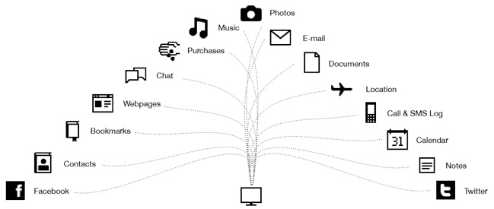
Information
Information - facts provided or learned about something or someone.
Data – electronic information
Many events generate data: humans, nature,
Automations,…
Video, Messages, sensors data
https://images.app.goo.gl/YH5BtUB66t7zZtWu9
Notes:
All

Slide 4
Data transmission
Internet traffic:
Data travels thru many means: computer networks, telecom networks, circuits inside a PC
From sender(place where the data is generated) to a receiver that stores the data or consumes it
Data can be sent with or without encryption
Continuous or batching
Pull,Push,Streaming
Storing for usage
Video Streaming | 48.9%
Social Networking | 19.3%
Web | 13.1%
Messaging | 6.7%
File Sharing | 1.3%
Cloud | 1.1%
VPN and Security | 0.9%
https://www.visualcapitalist.com/the-worlds-most-used-apps-by-downstream-traffic/
Notes:
All

Slide 5
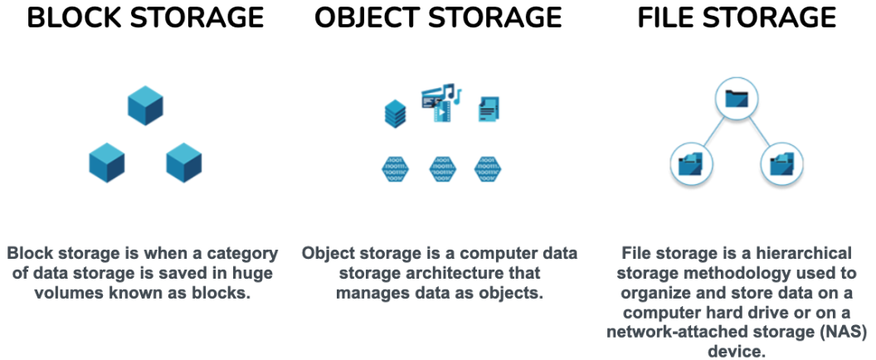
Data storage types
File, Blocks and Objects
Flat files, xlxs, propietray types
Services: API, DB, FTP
Notes:
All

Slide 6
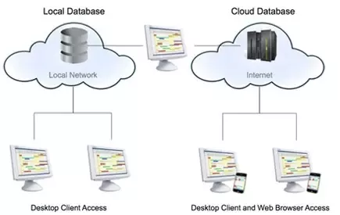
Data storage location
Local or Cloud
Local: Hdds,CDs, private datacenter
In Cloud: filesystem like, databases
Notes:
All

Slide 7
What is a database
Database - a database is an organized collection of data stored and accessed electronically. Small databases can be stored on a file system, while large databases are hosted on computer clusters or cloud storage
In PPB our dbs hold accounts, bets ,transactions, financial data
Notes:
All

Slide 8
Database
A database
Stores data in a proprietary mode
Reading/Writing the data thru a programming language (e.g. SQL)
Connect to a service
Performant data ops
Security
Compression
Notes:
All

Slide 9
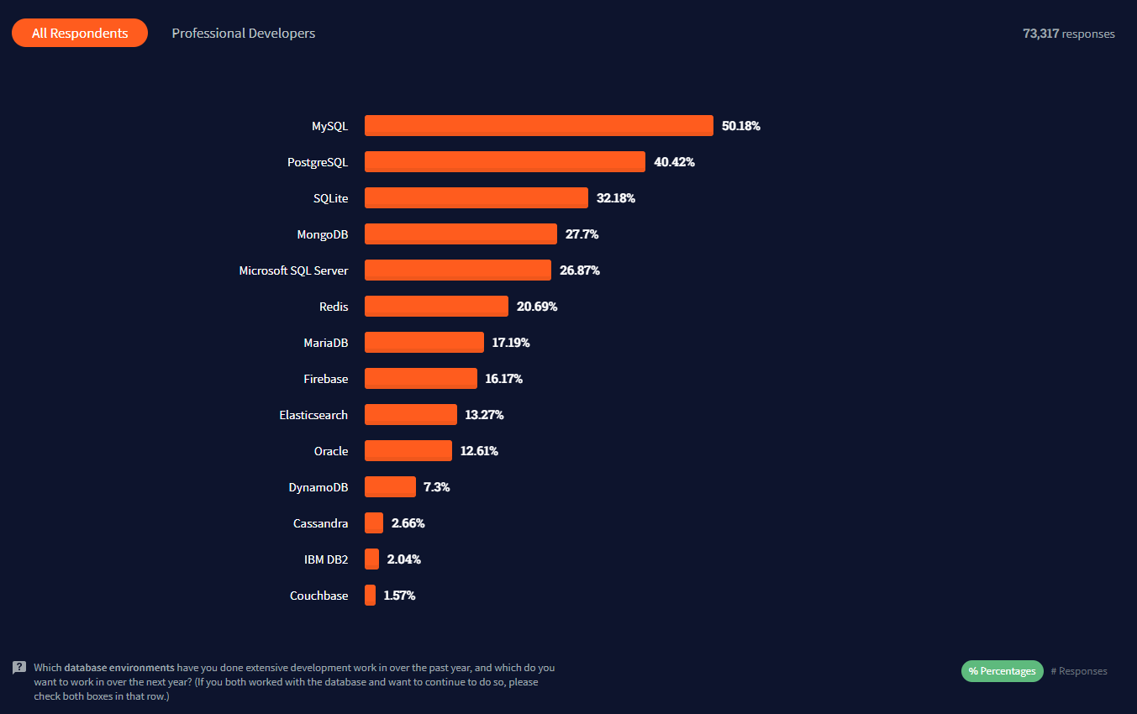
Database types
Database types
Data type: object, rows
Way of storing: columnar or row
SQL/ NoSQL
Single instance/Cluster
Notes:
All

Slide 10
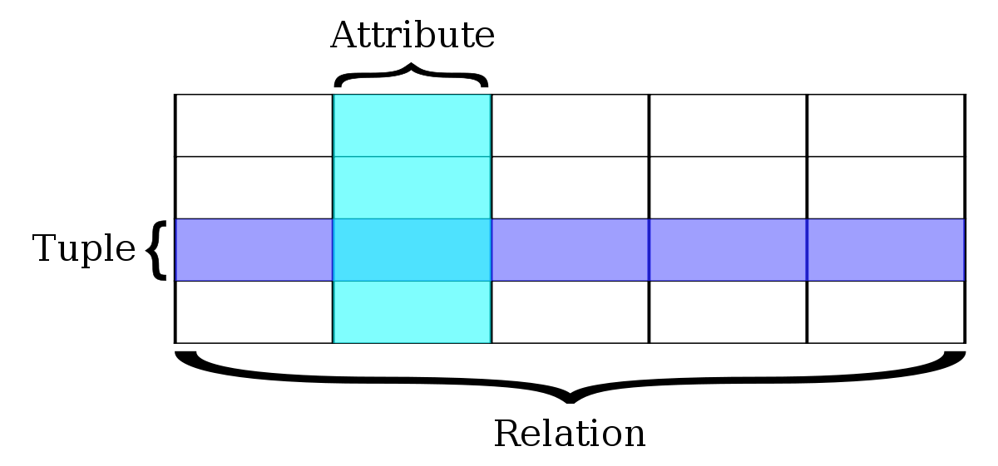
Relational database
Relational db: relation between attributes
Relational model: data into one or more tables (or "relations") of columns and rows, with a unique key identifying each row
There is a correspondence between tables data
Supports data manipulation with complex queries
Reporting
Transform and extract for other consumers
Data needs modeling
Notes:
All

Slide 11
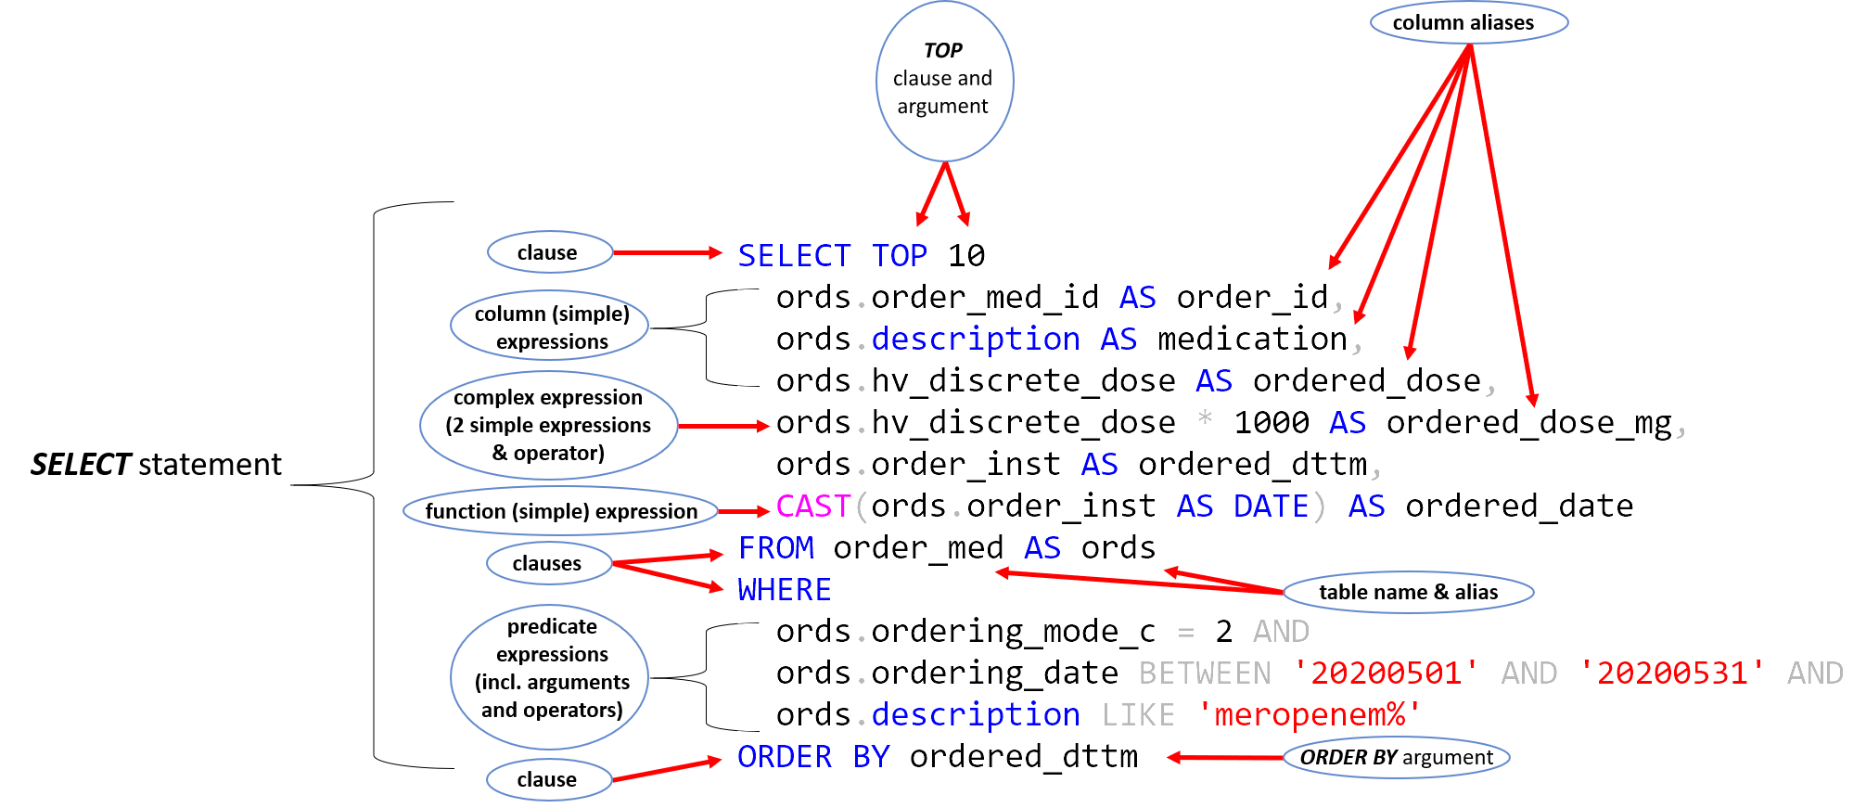
SQL
SQL has three main components: the Data Manipulation Language (DML), the Data Definition Language (DDL), and the Data Control Language (DCL).
Select statement parts
Notes:
All

Slide 12
Let’s connect
Using DBViz connect to a db and query some data
Notes:
All

